Slide 1
Chapter 5
Section 5.4–Scale Drawing

Slide 2
Scale Drawing
Section 5.4
p. 214
A scale drawing is a drawing such that all the ratios of lengths in the drawing to the actual lengths are equal.

Slide 3
Scale
Section 5.4
p. 214
The scale is the ratio of the length of a drawing to the actual length of the item drawn.

Slide 4
Section 5.4
p. 214
Scales can be written in two different ways.
1 in.
1 in. : 4 ft.
4 ft.

Slide 5
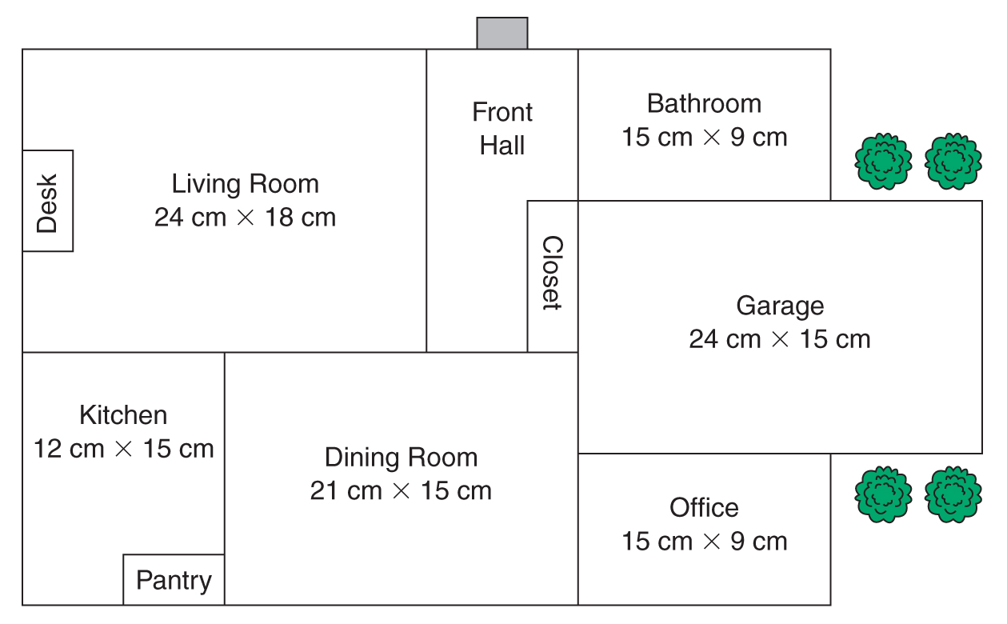
Section 5.4
p. 214

Slide 6
Section 5.4
p. 215
Example 1
Find the approximate distance from Pittsburgh to Philadelphia. The scale is 1 in. : 50 mi.
The distance on the map is about 5 in.
1
5
1 • n = 50 • 5
=
50
n
n = 250 mi.

Slide 7
Section 5.4
p. 215
Skill Check 1
Using the map of Pennsylvania, about how far is it between the cities listed?
1. Harrisburg to Altoona
2. Erie to Chambersburg
3. Gettysburg to Wilkes-Barre

Slide 8
Section 5.4
p. 215
Skill Check 1
4. The scale on a map is 1 cm : 3 km. Find the distance represented by 6.4 cm.
5. A scale drawing of a bridge uses the scale 3 cm : 10 m. If the bridge is 7 cm on the drawing, what is the actual length (round to tenths)?

Slide 9
Section 5.4
p. 216
Example 2
The dimensions of a house are 48 ft. by 42 ft. The dimensions on the floor plan are 8 in. by 7 in. What scale is used for the drawing?
Length in the drawing to the actual length:
8 in.
8 ÷ 8
1 in.
=
=
48 ft.
48 ÷ 8
6 ft.

Slide 10
Section 5.4
p. 216
Example 3
If a 14 ft. long table is 4 in. long on the drawing, what scale is used?
4 in.
4 ÷ 4
1 in.
=
=
14 ft.
14 ÷ 4
3.5 ft.

Slide 11
Section 5.4
p. 216
Skill Check 1
Find the scale used for the following.
1. A 35 km distance is 5 cm on a map.
2. A model of a 64 ft. coal car is 8 in. long.
3. A 12 ft. wide bedroom is drawn to be ¾ in. on the sketch.

